Slide 1
Cyclistic Bike Share Analysis
Guvi Assignment

Slide 2
Complete a Case Study
Introduction
In this case study, I will perform many real-world tasks of a junior Business analyst at a fictional company, Cyclistic. In order to answer the key business questions, I will follow the steps of the data analysis process: Ask, Prepare, Process, Analyze, Share, and Act.

Slide 3
Ask
Business Task
Devise marketing strategies to convert casual riders to members.
Analysis Questions
Two questions will guide the future marketing program:
How do annual members and casual riders use Cyclistic bikes differently?
How to convert casual riders into annual members?

Slide 4
Prepare
Data Source
This is public data that can be used to explore how different customer types are using Cyclistic bikes. But note that data-privacy issues prohibit from using riders’ personally identifiable information. This means that we won’t be able to connect pass purchases to credit card numbers to determine if casual riders live in the Cyclistic service area or if they have purchased multiple single passes.

Slide 5
Process
A CSV file have 5L+ rows and load in to Microsoft PowerBI Desktop because of it will take copy of large amounts of data. Hear i'm choosing PowerBI tool because i am familiar with this tool it is essential to use a platform like User friendly and easy to data Preprocessing use along huge volumes of data.

Slide 6
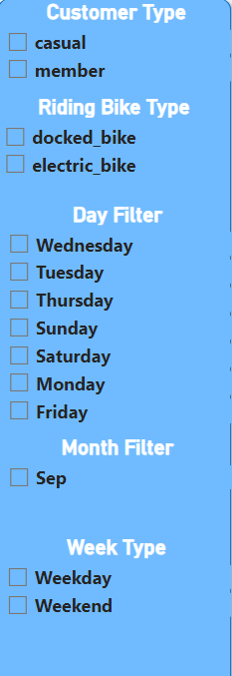
Analyze and Share
In power bi can do Dashboard Level Filter called Slicer.
Various methods of filters based on columns
Customer Type
Type of Bike
Days, Month, Type of Week

Slide 7
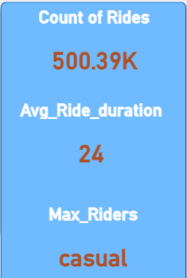
Cards:
Cards are very useful to view the Exact values
Hear i shows:
Count of Rides
Average riding durations
Maximum Type of raiders

Slide 8
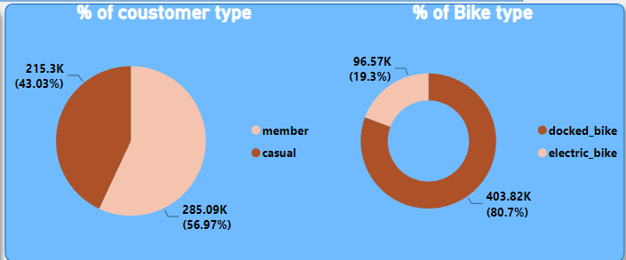
Pi Charts and Donut chart:
Pi charts shows % of casual and membership customers.
Donut charts shows % of customers mostly used of bikes.

Slide 9
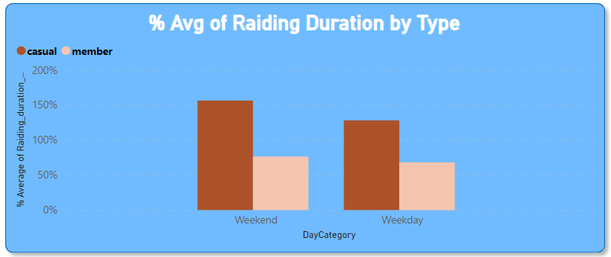
Customers avg used in which weekdays by customers Category:
X-axis Weekends & Weekdays by Y-axis Raiding Duration in Minutes.

Slide 10
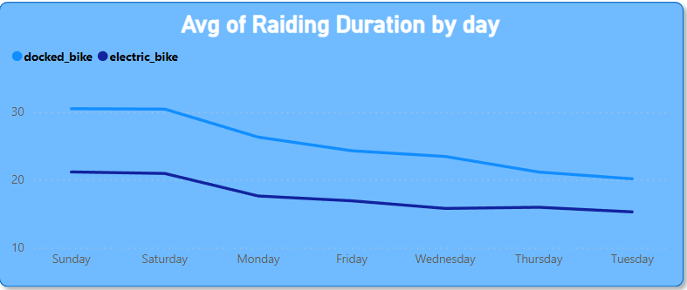
Customers avg used in which days by Bike Category:
X-axis days by Y-axis Raiding Duration in Minutes.
Two types of bikes used customers

Slide 11
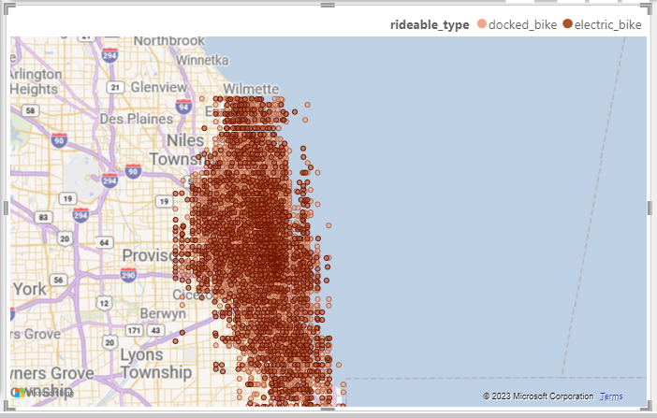
Map Location of types Bike used:

Slide 12
Act:
After identifying the differences between casual and member riders, marketing strategies to target casual riders can be developed to persuade them to become members.
Recommendations:
Marketing campaigns might be conducted in spring and summer at tourist/recreational locations popular among casual riders.
Casual riders are most active on weekends and during the summer and spring, thus they may be offered seasonal or weekend-only memberships.
Casual riders use their bikes for longer durations than members. Offering discounts for longer rides may incentivize casual riders and entice members to ride for longer periods of time.

